Slide 1
Welcome To Hostel Management System

Slide 2
Introduction
This is a project work undertaken in context of partial fulfilment of BBA(CA)|| have tried my best to make the complicated process of Hostel Management System as simple as possible using structured and modular technique.
Project title “Hostel Management System”(a project for keeping students Records.)Hostel Management is The application of project management to the creation and development of hostels.Hostel management involves small sub_modules which have one unique base module&which is describes the all event details.This details are basically made for the Targeted customers the customer who wanted to plan and event they refer the system.

Slide 3
Very few Hostel Management system maintain some of the data computerizedlist ,vendor list,etc.
We design hostel management system to facilitate the hostel admin in the Hostel management.
Hostel Management project is very user friendly software that Is why they do not require specially trained person to handle the software.
Hostel Management project can automatically calculates all the bills and gives proper notifications wherever it is required .

Slide 4
Company Profile
Name:C.D.Jain Girl’s Hostel
Name of Owner:C.D.Jain College
Contact no:025678993478
Email:office@cdjcollege.com
Establish Year:2007-2008
Rector Name: kiran Bhakre
Rector Contact no:8976547890

Slide 5
SCOPE OF THE SYSTEM
This system is aimed at total user-friendly as well as
Efficient Management of varied tasks. These tasks may range from
registering new students, managing admission of students, examination
management to all the essential features necessary for making the
administrative division of college effective.

Slide 6
OBJECTIVE OF SYSTEM
1.Maintain the students as hostellers and waiting list students separately.
2.Process allotment list.
3.Admin can send the approval notification to every approved student via Automatically insert student’s details to the hosteller’s record when the allotment is confirmed by the admin and deleted when vacation is confirmed or after the course end date.
4.Students can register their complaints.

Slide 7
NEED OF THE SYSTEM & EXISTING SYSTEM
The existing system is manual based and need lot of efforts
and consume enough time. In the existing system we can apply for the
hostels online but the allotment processes are done manually. It may lead
to corruptions in the allocation process as well as hostel fee calculation.
The existing system does not deals with mess calculation and complaint registration

Slide 8
5.Admin can edit notice board and each student can view it.
6.Hostel secretary can calculate hostel fee including mess fee and can edit mess Menu.
7.Hostellers can check the status of every month’s hostel fee.

Slide 9
PROPOSED SYSTEM
The proposed system is having many advantages over the existing system. It require less overhead and very efficient. The proposed system deals with the mess calculation and allotment process efficient.
The development of this new system contains the following activities, which try to automate the entire process keeping in the view of database integration approach.
This system maintains employee’s personal, address and contact details. This system will provide online help and search capabilities.
User friendliness is provided in the application with various controls provided by system rich user interface. Authentication is provided for this application only registered users can access. Event information files can be stored in centralized database which can be maintained by the system. This system provides the employee to manage the system systematically.

Slide 10
FEASIBILITY STUDY
1.FEASIBILITY STUDY TECHNICAL FEASIBILITY
The technical feasibility in the proposed system deals with the technology used in the system.
It deals with the hardware and software used in the system whether they are of latest technology or not.
It happens that after a system is prepared a new technology arises and the user wants the system based on that technology.This system use windows platform, .net as front end technology and sql server as backend technology. Thus ONLINE HOSTEL MANAGEMENT SYSTEM is technically feasible.

Slide 11
2.ECONOMICAL FEASIBILITY
Economic analysis is the most frequently used method for evaluating the effectiveness of a new system. More commonly known as cost/benefit analysis.
3.OPERATIONAL FEASIBILITY
The project has been developed in such a way that it becomes very easy even for a person with little computer knowledge to operate it. This software is very user friendly and does not require any technical person to operate. Thus the project is even operationally feasible.

Slide 12
8.FACT FINDING TECHNIQUE
1.Fact Finding Technique
When stating work on system,system analyst has to collectinformation about the manual system from user.
In order to developed this information system analyst prefers any one of the following fact finding techniques or prefer one or more fact finding technique
according to the situation. These techniques are as follows.

Slide 13
• Record Searching:
Information was collected through some document,bills,some extra
records of student,or information storing way all this details maintained by Shop Owner.
User give the details of the procedure how they sells, buy the product to customer and do mortgage, how they maintain their records.

Slide 14
In some situation are they take extra charges from customer?
Which type of or names do they sell?
• What type of details you take from customer,reference person?
Questionnaires:
We have used this fact finding technique as a supplement to our interviews By questioning the hostel we have been able to study the system management and have been able to collect good data regarding our project question like

Slide 15
Questionnaire list:How do you maintain records?
How do you maintain admission records?

Slide 16
• Observation:
"Observation allows getting the information which may be useful for…. Details about the products ie their types, making type..
Information abou thow selling is done for artificial jewellery and also some temporary items requires for worship, functions etc.
. How to calculate the mortgage amount ?
.How they maintain the manually record of customer?.
There expectation from our computer system?

Slide 17
. In some situation are they take extra charges from customer?Which type of or names do they sell?
• What type of details you take from customer,reference person?
.How they maintain the manually record of customer?.
There expectation from our computer system?
. In some situation are they take extra charges from customer?
Which type of or names do they sell?
• What type of details you take from customer,reference person?

Slide 18
SOFTWARE/HARDWARE SPECIFICATIONS
Frontend-HTML
Backend-PHP
1.Software Platform
.Mysql-Backend
. Wamp-Server

Slide 19
Operating System
. Windows11
2.Hardware Platform
.500gb of harddisk
.4gb ram
.Printer

Slide 20
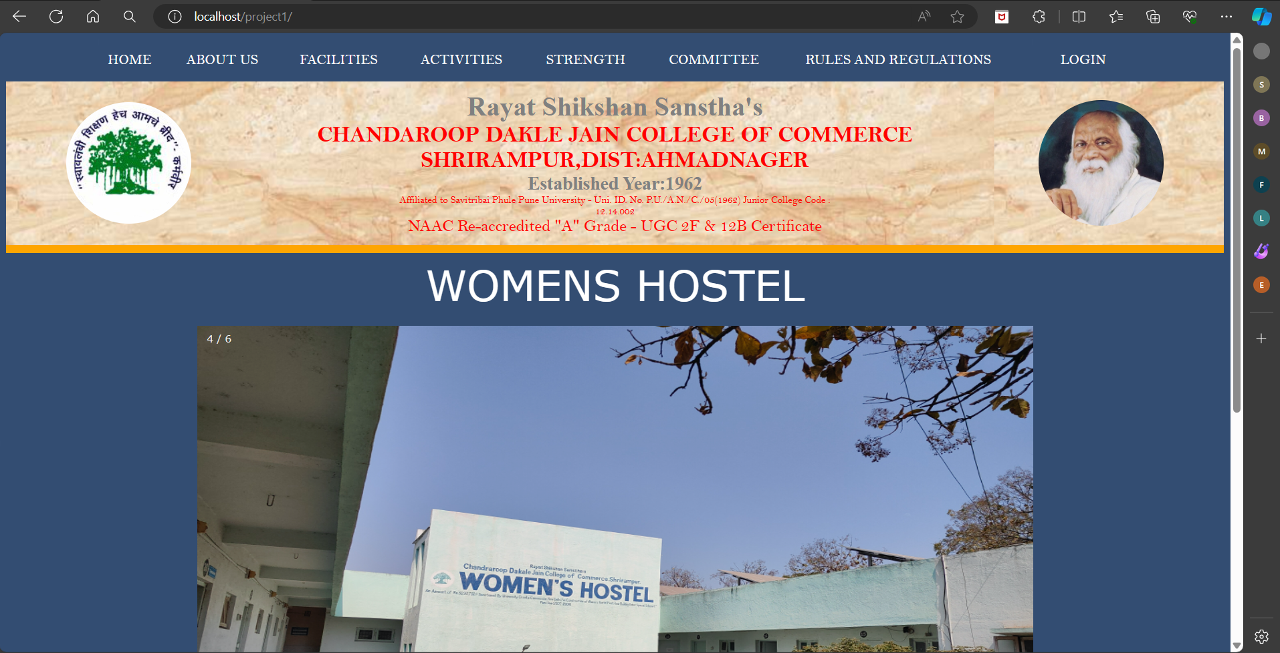
SCREENSHOT: Main Page:

Slide 21
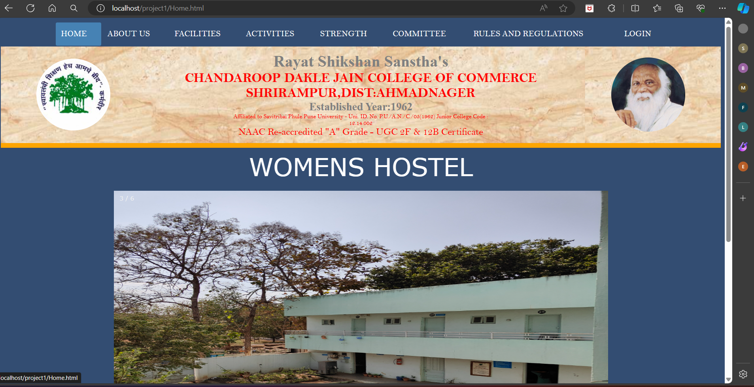
HOME PAGE

Slide 22
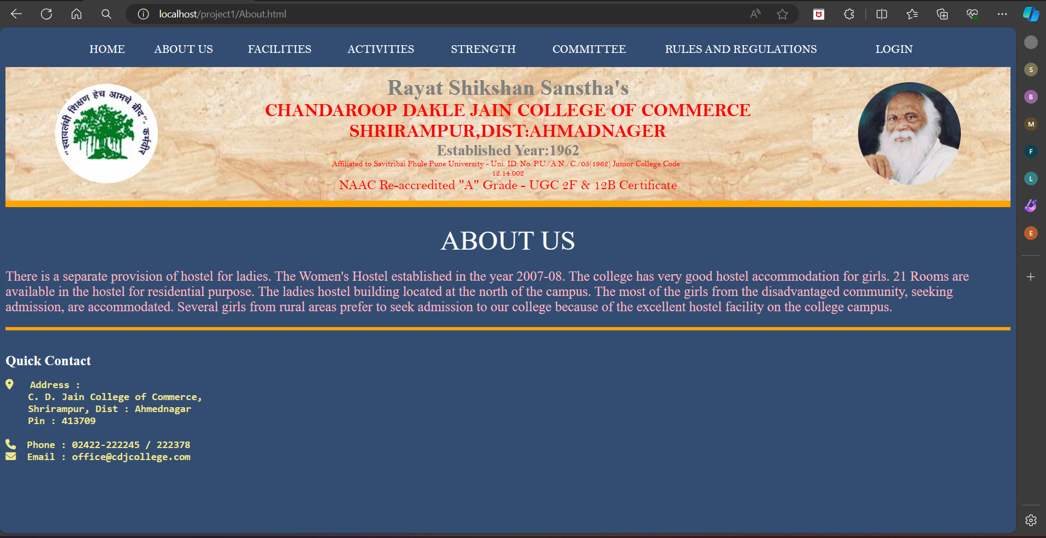
ABOUT

Slide 23
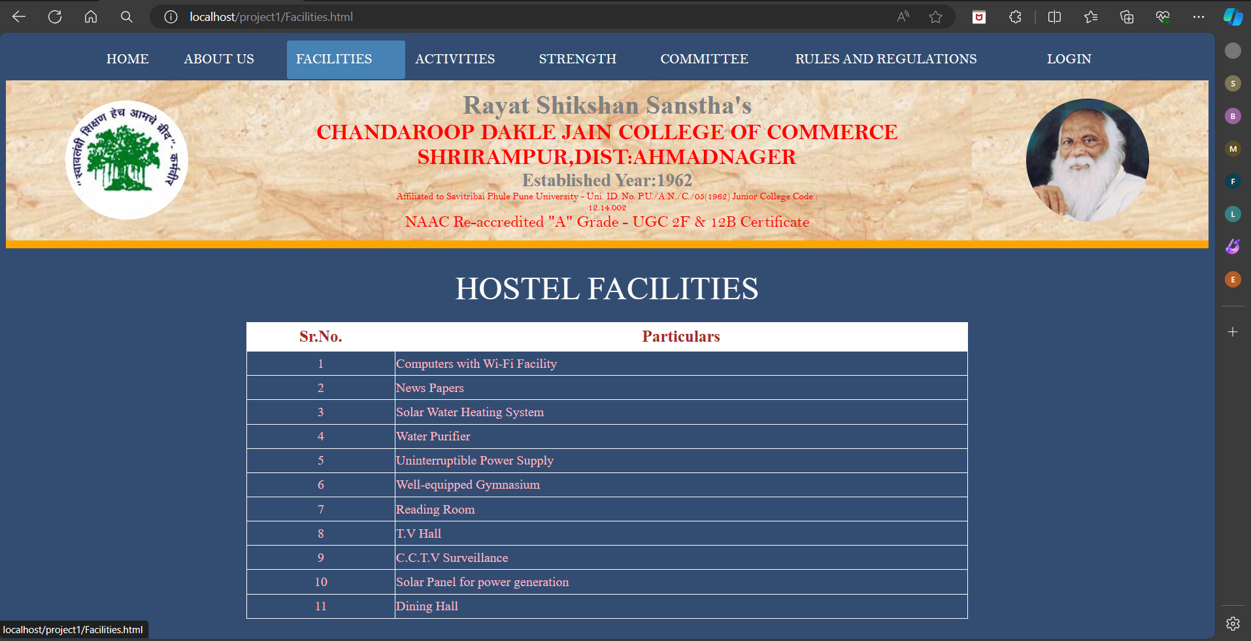
FACILITY:

Slide 24
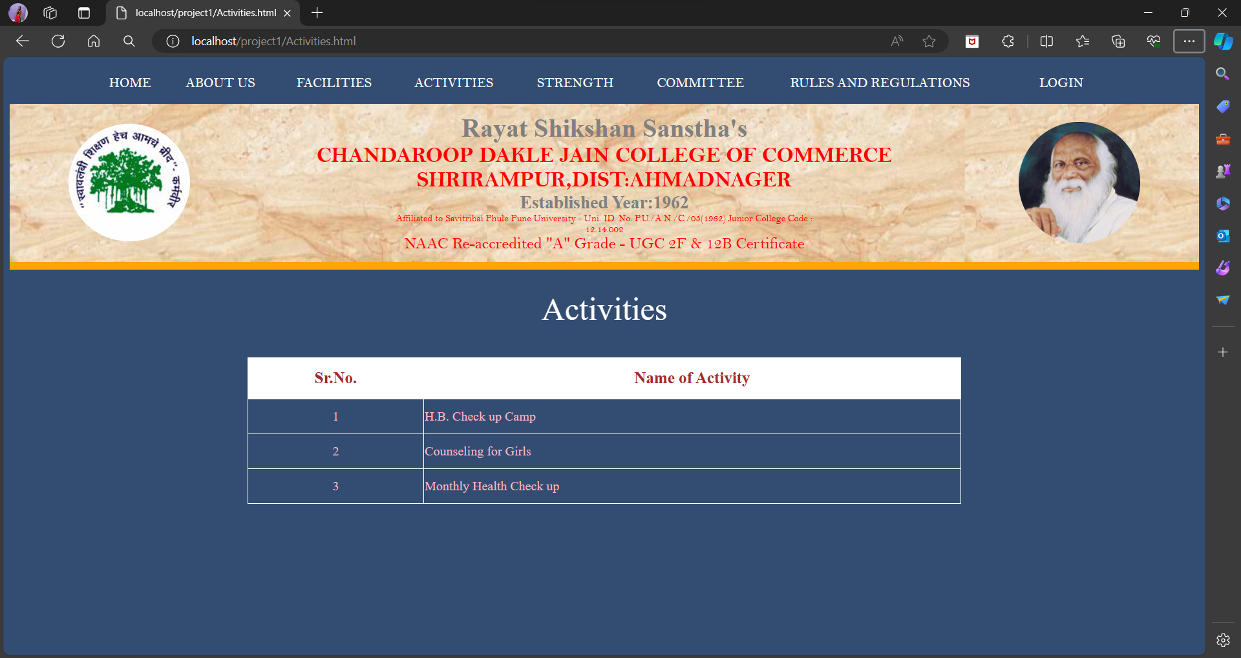
ACTIVITIES

Slide 25
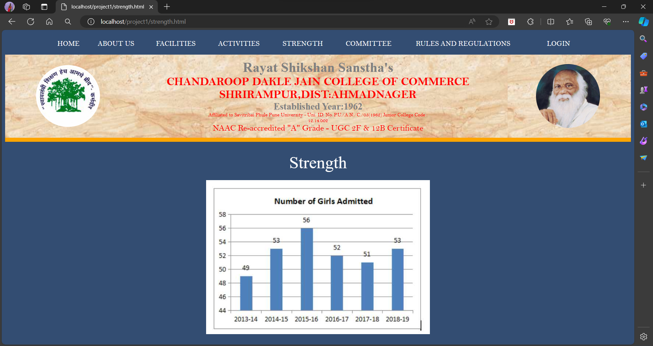
Strength

Slide 26
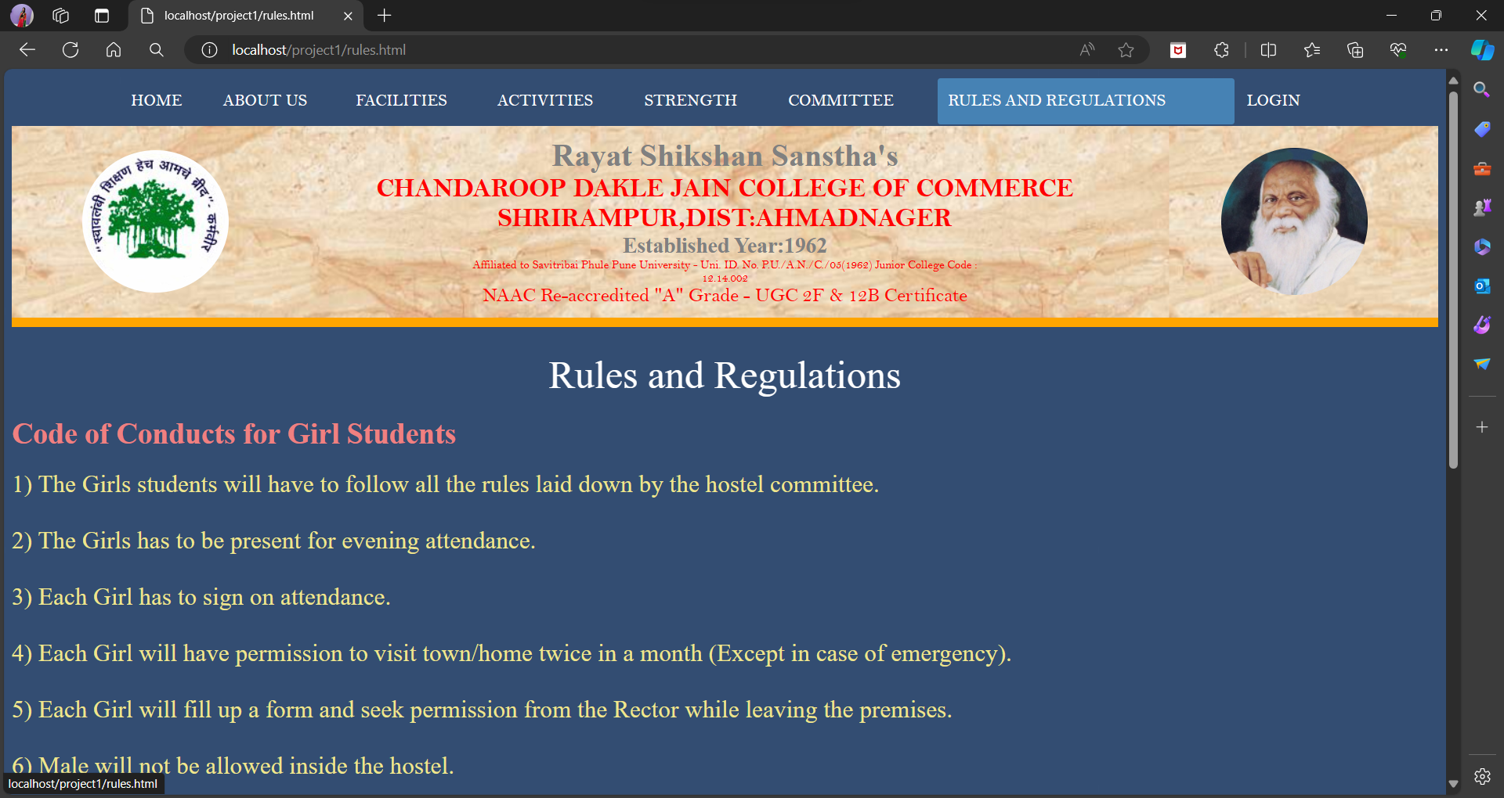
Rules and Regulations

Slide 27
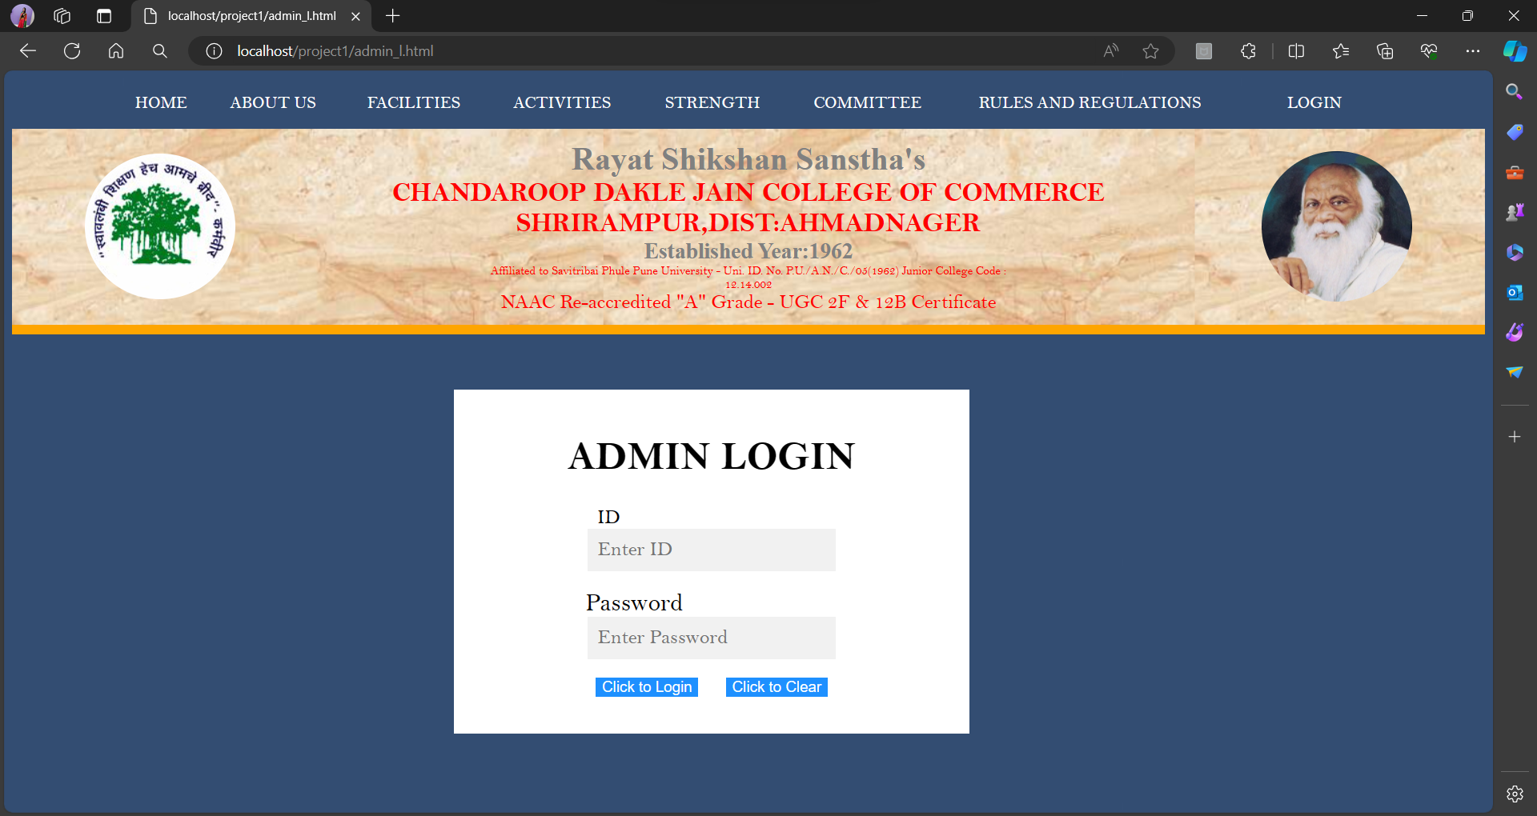
Admin Login

Slide 28
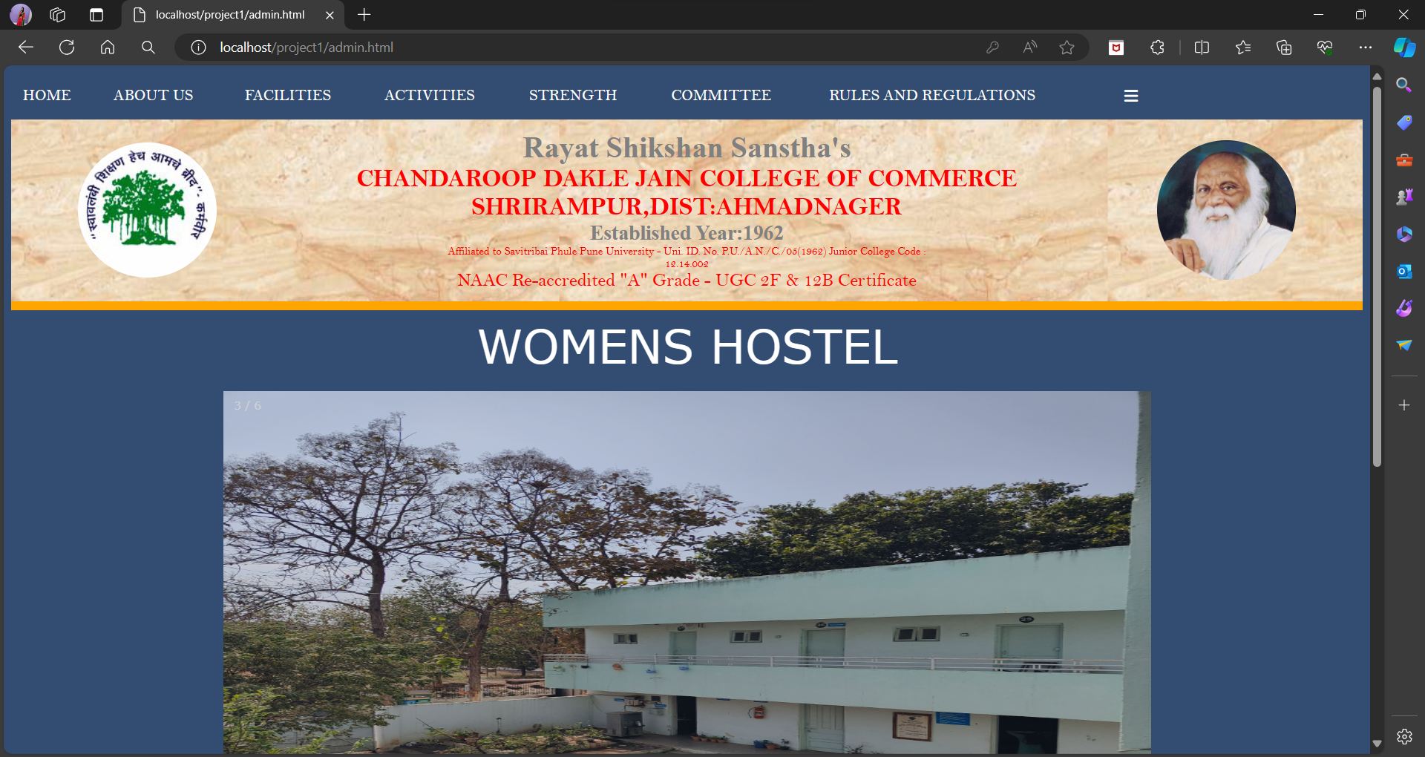
Admin Page

Slide 29
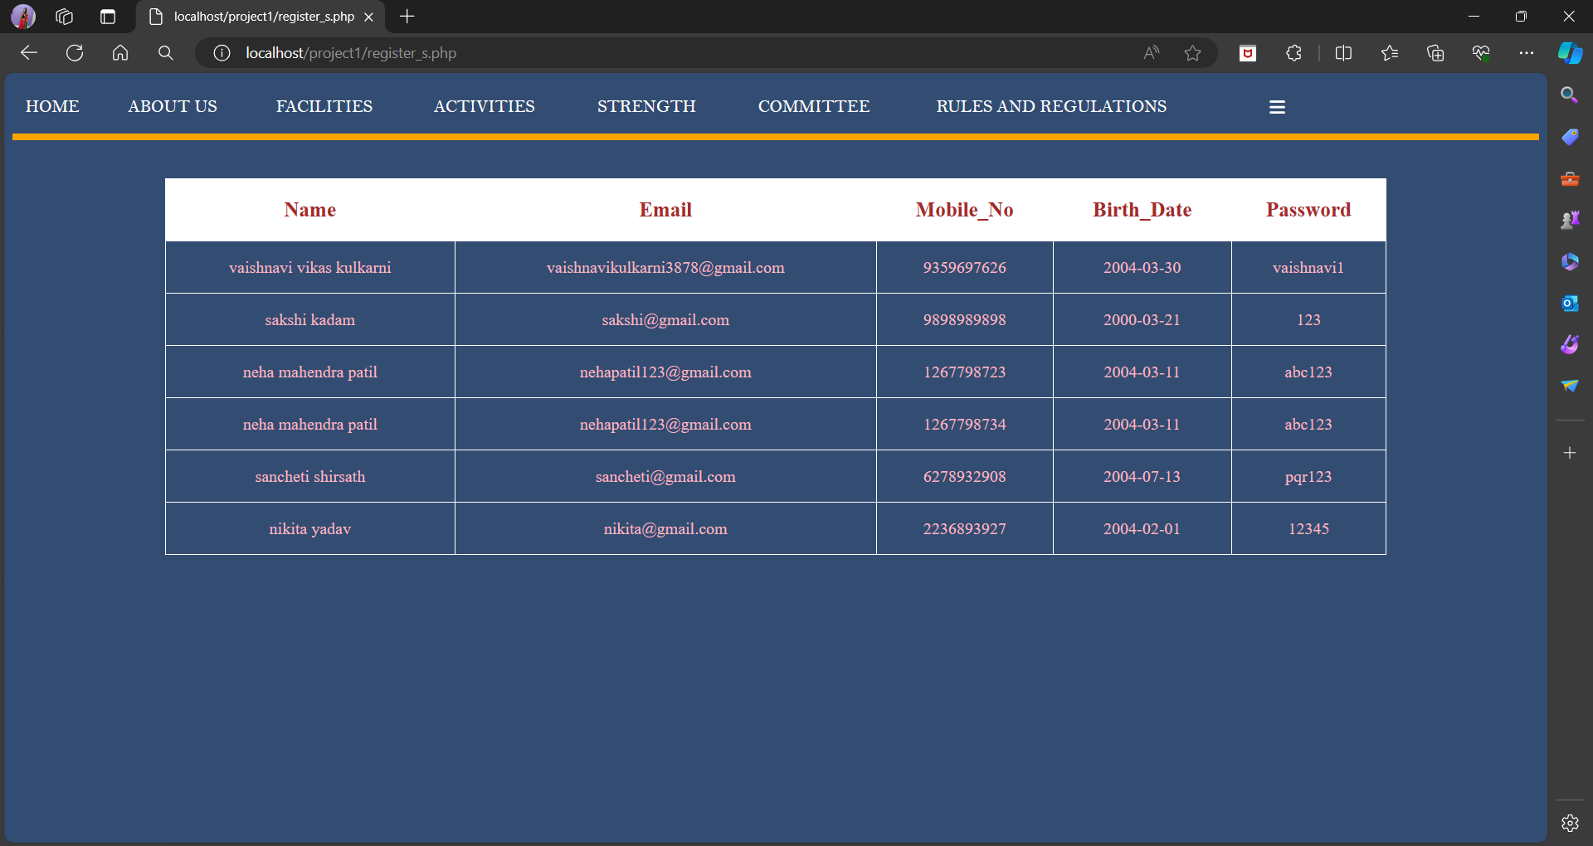
Registered Students Records

Slide 30
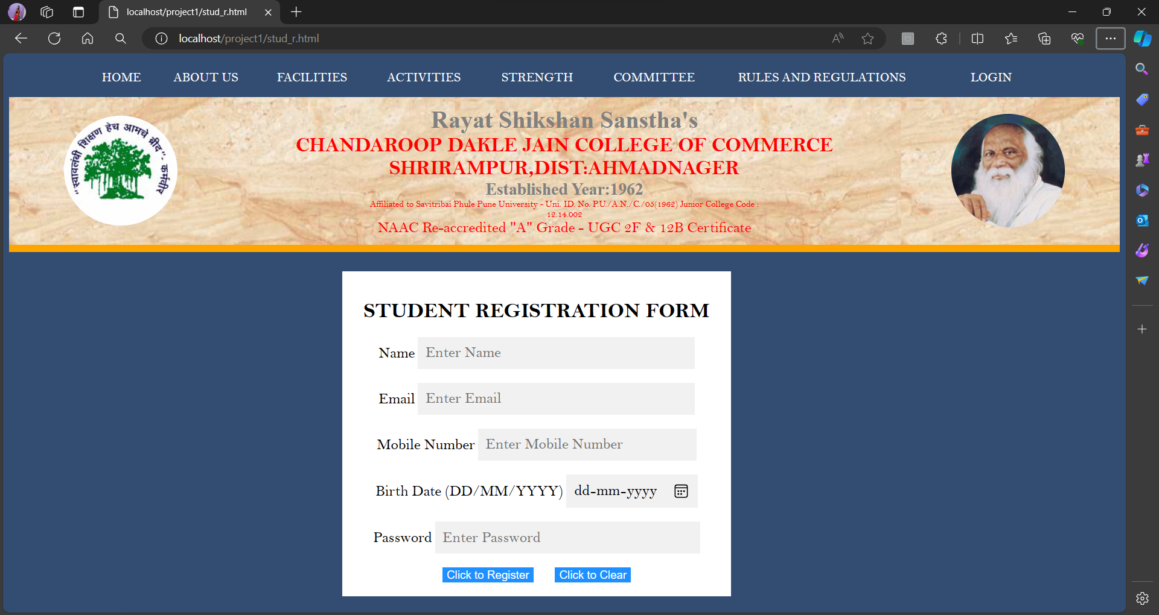
Student Registration

Slide 31
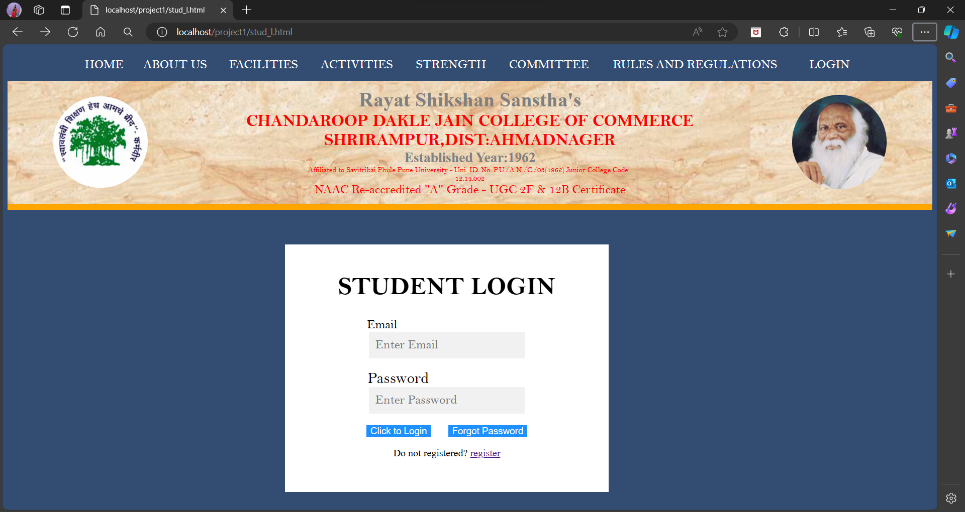
Student Login

Slide 32
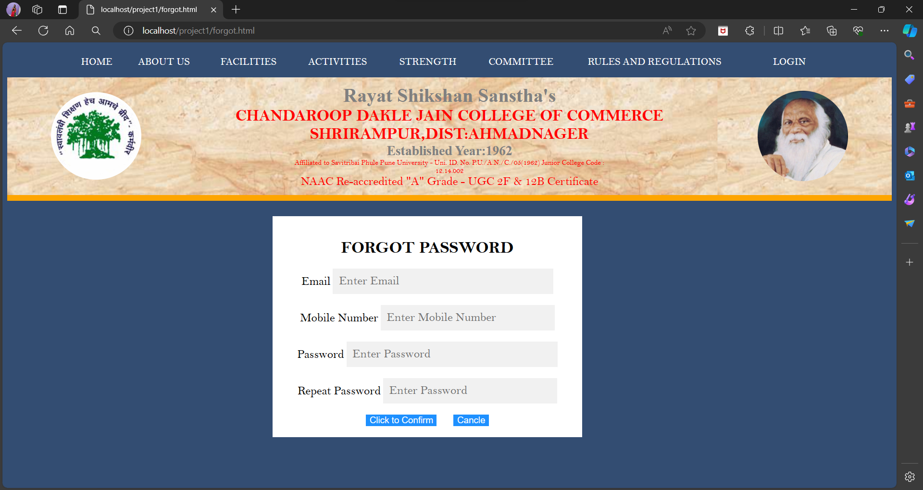
Update Student Password

Slide 33
Student Page

Slide 34
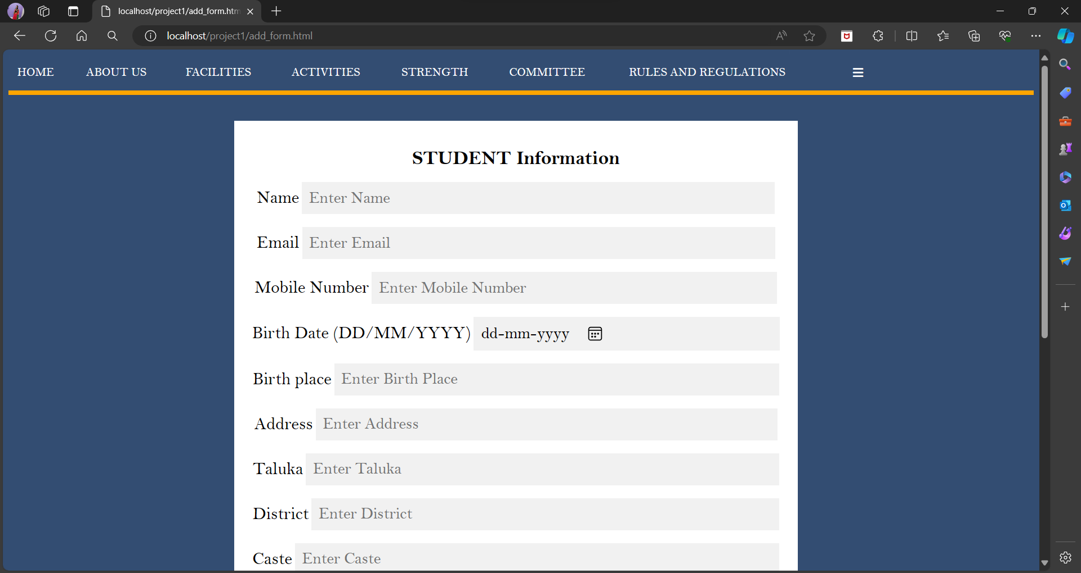
Addmission Form

Slide 35
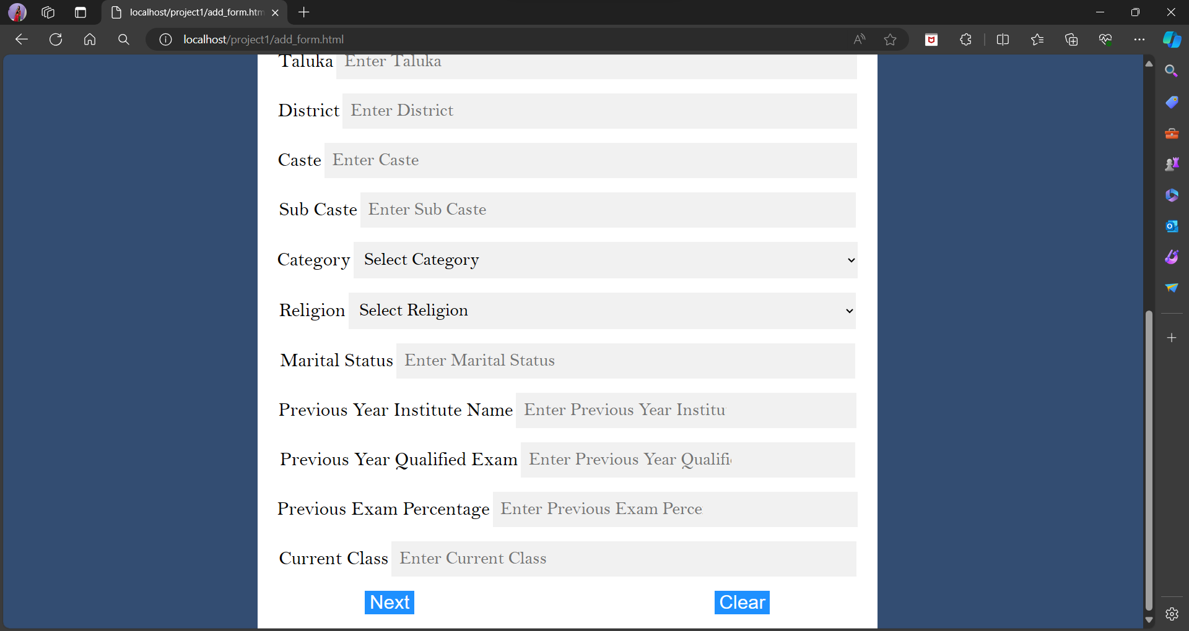

Slide 36
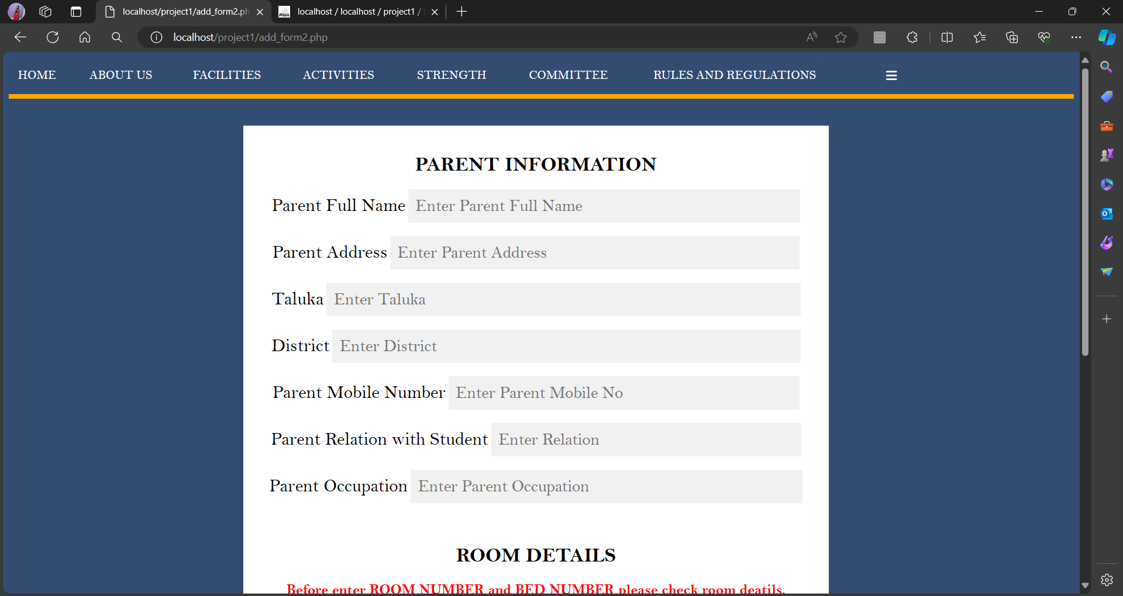

Slide 37
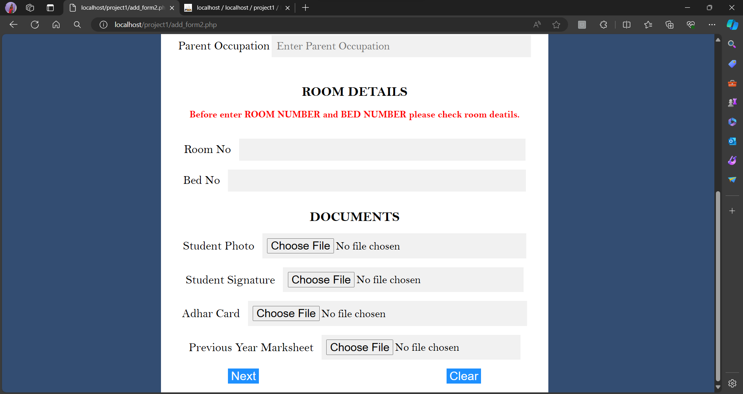

Slide 38

---------------------------------Thank You…..!---------------------------------

